Slide 1
Data Scientist Assignment
Candidate: Alket Cecaj Ph.D

Slide 2
Outline
A first Exploratory Data Analysis that helps with better understanding the data, maybe ask some interesting questions and go from data to answers.
The Cohort Analysis that aims to group the users by presence and show how their behavior evolves in time. This part is strumental to the next point.
The Model: a linear regression model that takes the data prepared previously and computes a first prediction.
Summary and conclusions where I address each of the questions in the assignment and try to give recommendations on each one.

Slide 3
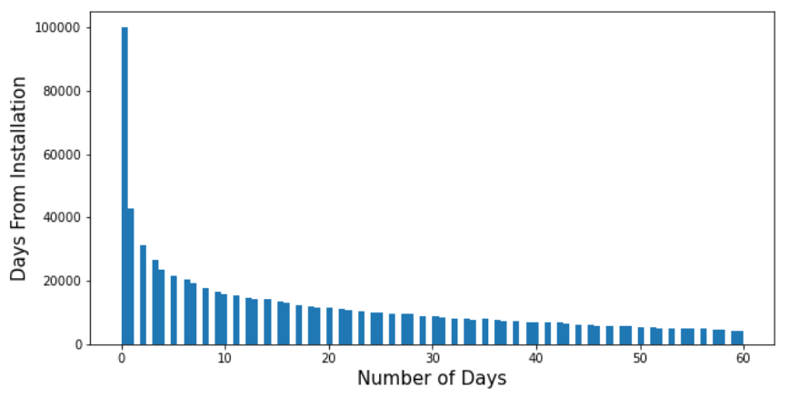
Exploratory Data Analysis
How are distributed some of the most interesting variables in the dataset, first of all the :

Slide 4
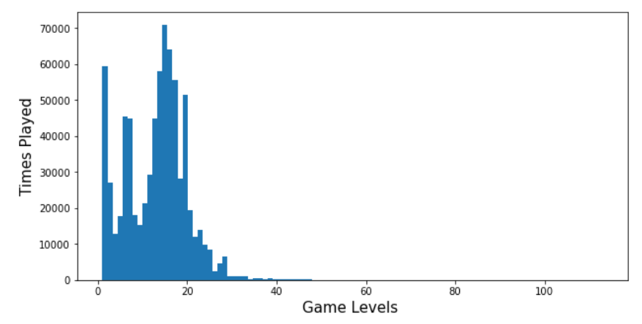
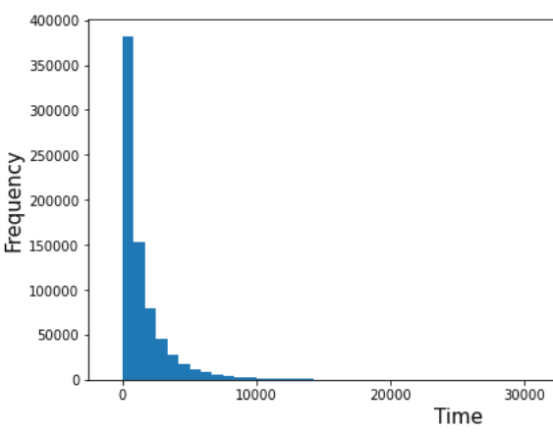
Exploratory Data Analysis
The Game Level and Time Played variables

Slide 5
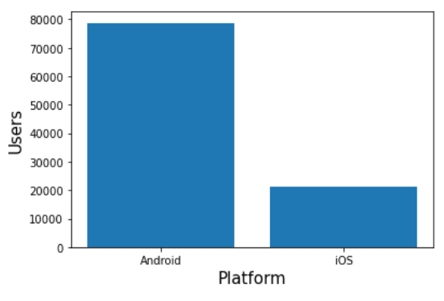
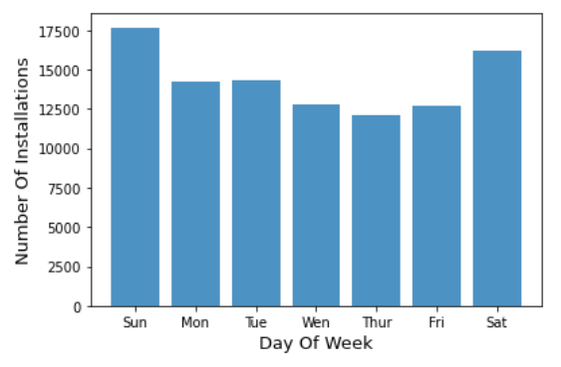
Exploratory Data Analysis
Platform and DoW variables bar charts

Slide 6
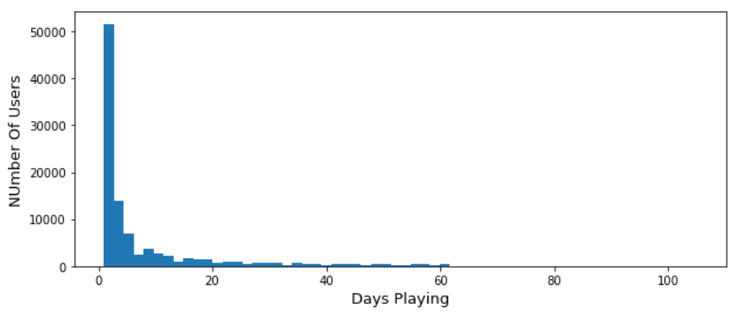
Exploratory Data Analysis
Frequency distribution with which users has been playing during the 60 days period

Slide 7
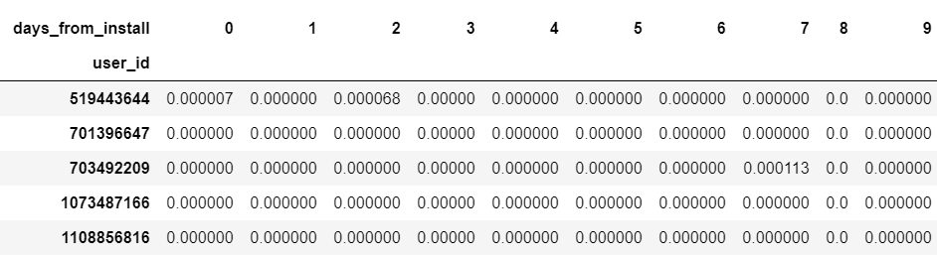
Cohort Analysis
A pivot table for computing a user’s ad and iap revenue each day.

Slide 8
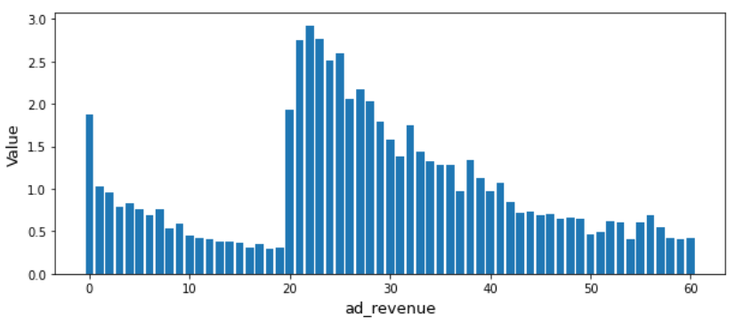
Cohort Analysis - Ads Revenue
The revenue from ads and how it evolves in the 60 days period

Slide 9
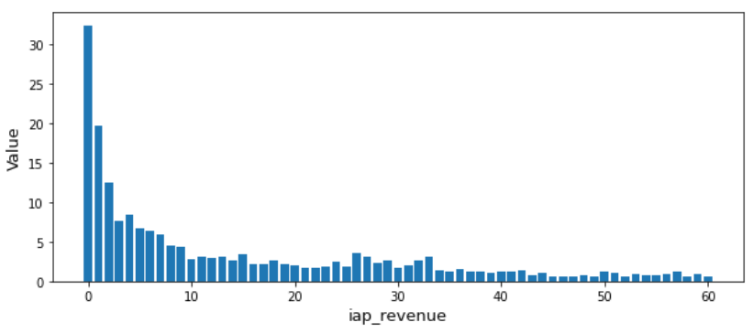
Cohort Analysis - In App Revenue
The in app revenue during the 60 days period

Slide 10
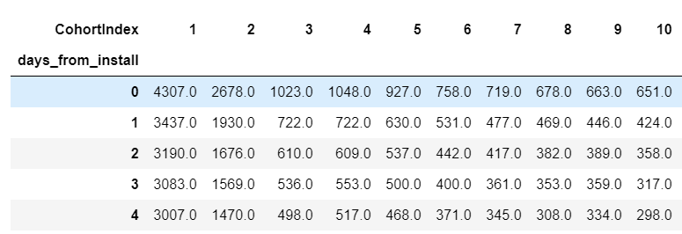
Cohort Analysis - Users Count
With another pivot table I aggregate the users in cohorts based on the number of days from install.

Slide 11
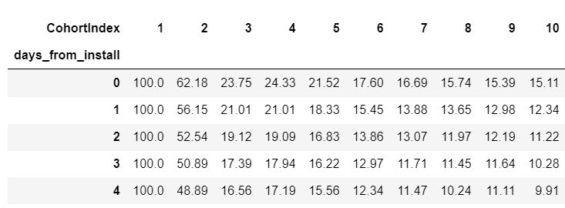
Cohort Analysis - Retention Rates
The retention rate during the 60 days period

Slide 12
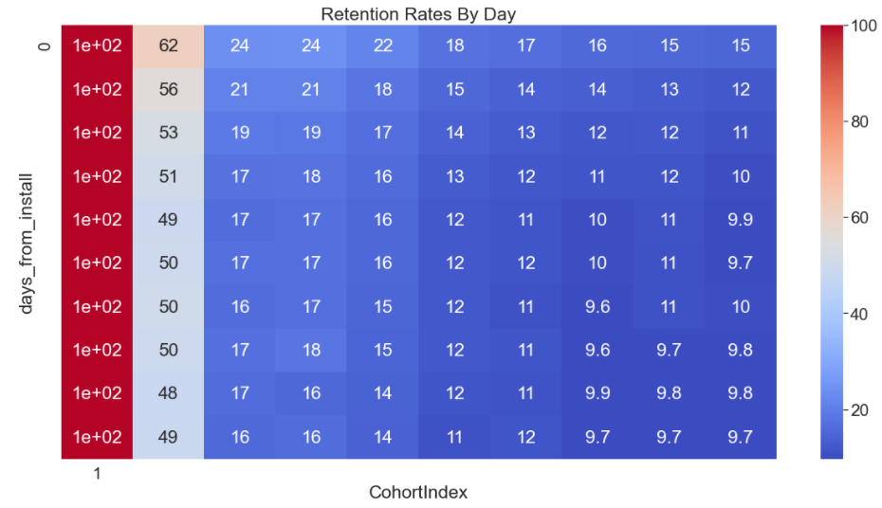
Cohort Analysis - Retention Rates Viz.
Visualization of a small portion of the retention rate pivot table.

Slide 13
Cohort Analysis - Some Numbers
Some interesting statistics..
Number of users generating revenue by watching ads = 41011
Number of users making at least one in-app-purchase = 5240
Total revenue from ads in $ = 62.9
Total revenue from in app purchase (normalized) = 193.9
Average ad revenue per user watching ads in $ = 0.002
Average in-app-revenue per buying user (normalized) = 0.037

Slide 14
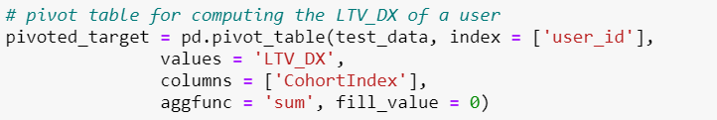
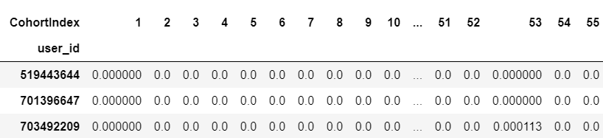
The Model: a linear regression model - 1
For making the predictions I have been using a Linear Regression Model.
The model takes as a matrix a features X, the 60 days of a pivot table that I built as follows:

Slide 15
The Model: a linear regression model - 2

Slide 16
Answers to the questions - 1
Question 1 : Considering that the marketing campaign costs equal to 400 dollars , will the campaign be profitable after one year?
The answer to this question depends a lot on the retention rate. For example, if the retention rate is near to zero then the subscribes that have been acquired during the campaign will continue to generate revenue (through ads or in app purchases).
By computing the retention rate as a percentage change of the first column in the pivot table that counts the number of users in each slot, it is possible to give an estimate.

Slide 17
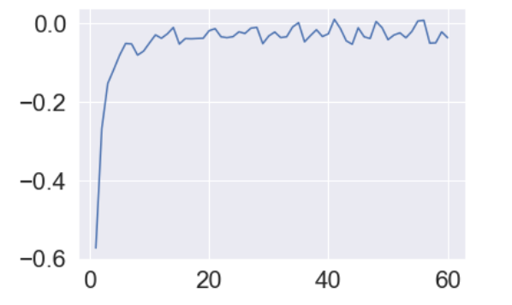
Answers to the questions - 1
The number of users leaving the company will eventually converge to zero as the graphics below shows
At the end of the 60 days period there are still 4152 users which seem to be loyal customers.

Slide 18
Answers to the questions- 2
Question 2 : Assuming that the campaign will not be profitable after one year: Will the campaign ever be profitable?¶
If the campaign will be profitable this depends on the churn rate and the customer lifespan. If the customer lifespan goes from two to three years and the churn rate remains close to zero then the campaign will become profitable.

Slide 19
Answers to the questions- 2
Question 3 : Given the obtained results, what would you recommend regarding this type of investment?
From what I learned from the data I would recommend that this type of investment is profitable.
Which confidence can you provide on your recommendation? The confidence is provided by the p-value in the regression model that I presented and it is close to 99%
Which is the maximum amount that would you recommend to pay for every new game user? I was not able to compute this number!

Slide 20
Conclusions

